Slide 1

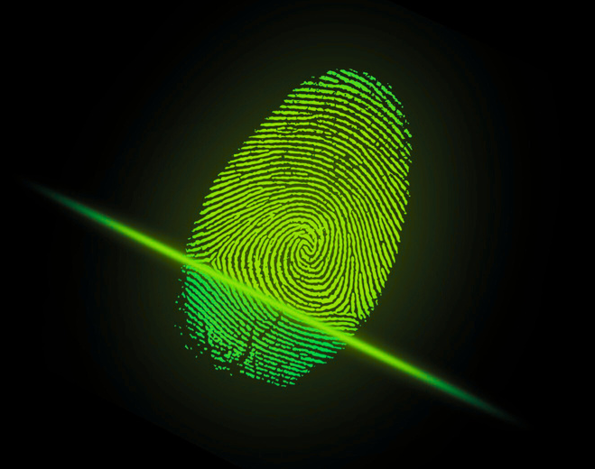


01.15.2026
THE HUMAN FIREWALL
DIGITAL SAFETY STARTS WITH YOU

Slide 2
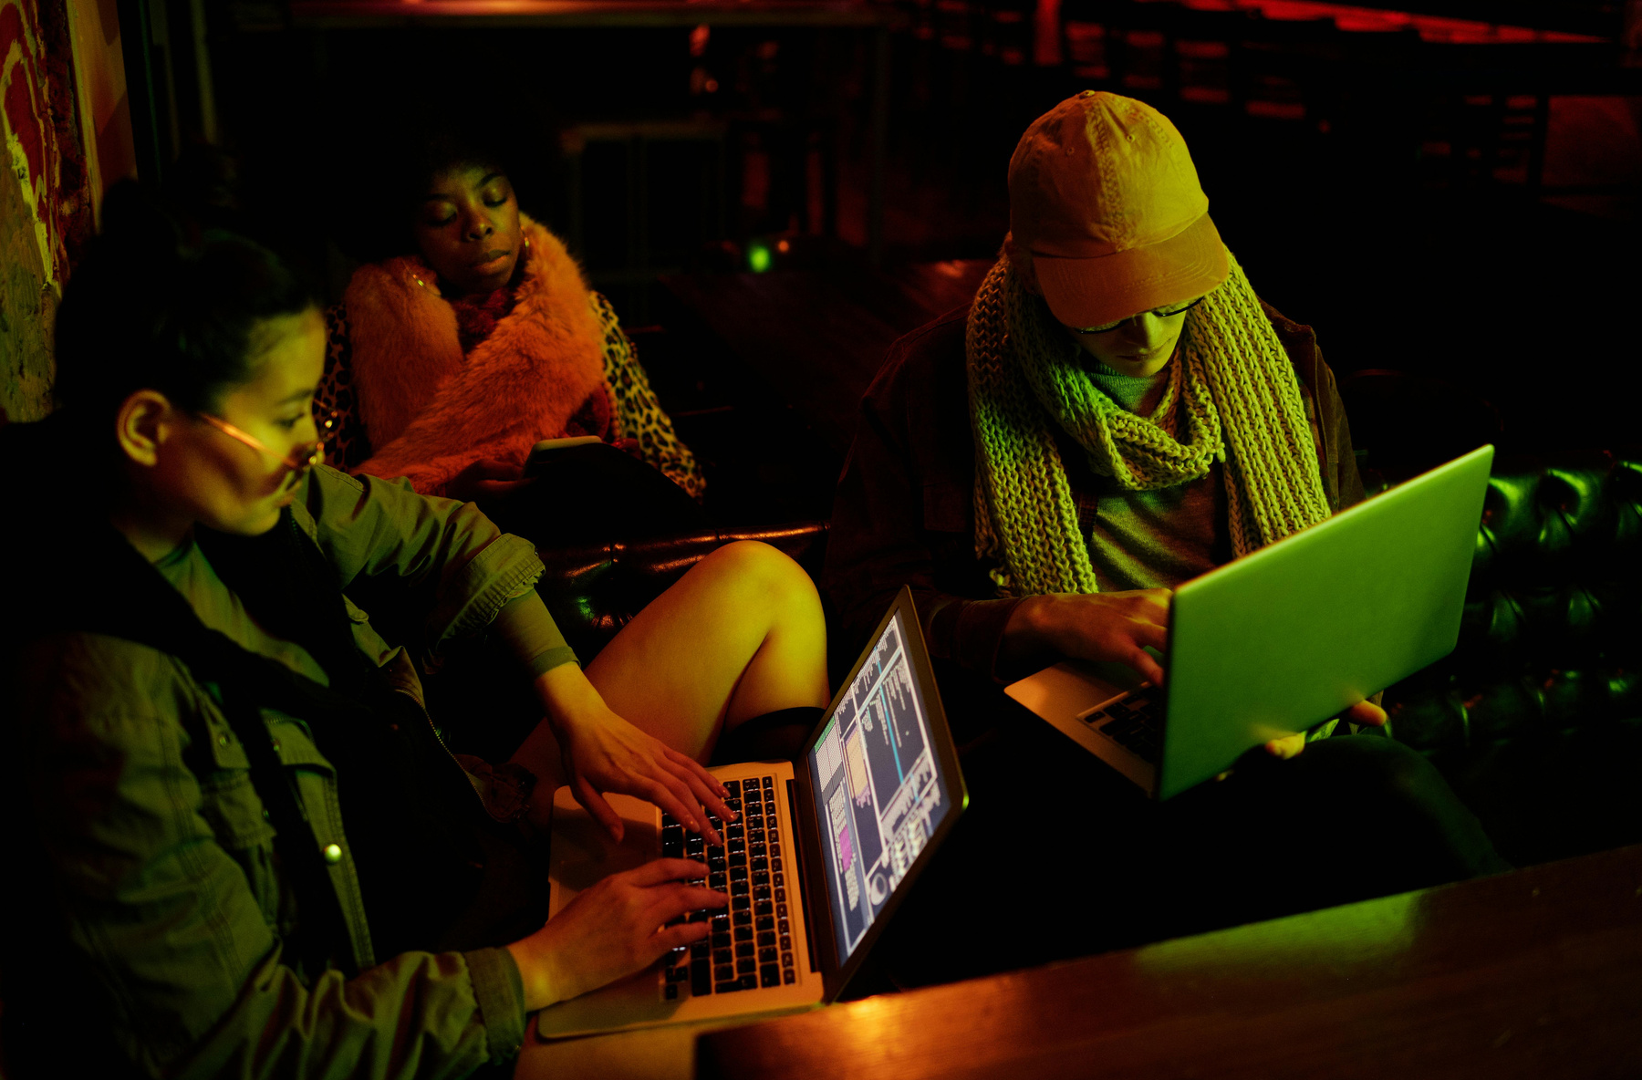

01.15.2026
INTRODUCTION TO
Key stat
CYBERSECURITY
95% of cybersecurity breaches are caused by human error.
What is cybersecurity?
Cybersecurity is the practice of protecting systems, networks, and data from digital attacks, theft, and damage. It involves technologies, processes, and awareness training that help organizations and individuals defend against threats like phishing, malware, and hacking. In the context of phishing awareness, cybersecurity emphasizes recognizing suspicious emails or messages, avoiding malicious links or attachments, and safeguarding sensitive information to prevent attackers from gaining unauthorized access.
Why it's more relevant than ever
Rising phishing attacks: Scammers use convincing emails and messages to trick people into revealing sensitive data.
High financial impact: Breaches can cost companies millions in recovery, fines, and lost trust.
Global scale: Cyberattacks can disrupt governments, supply chains, and critical infrastructure.

Slide 3
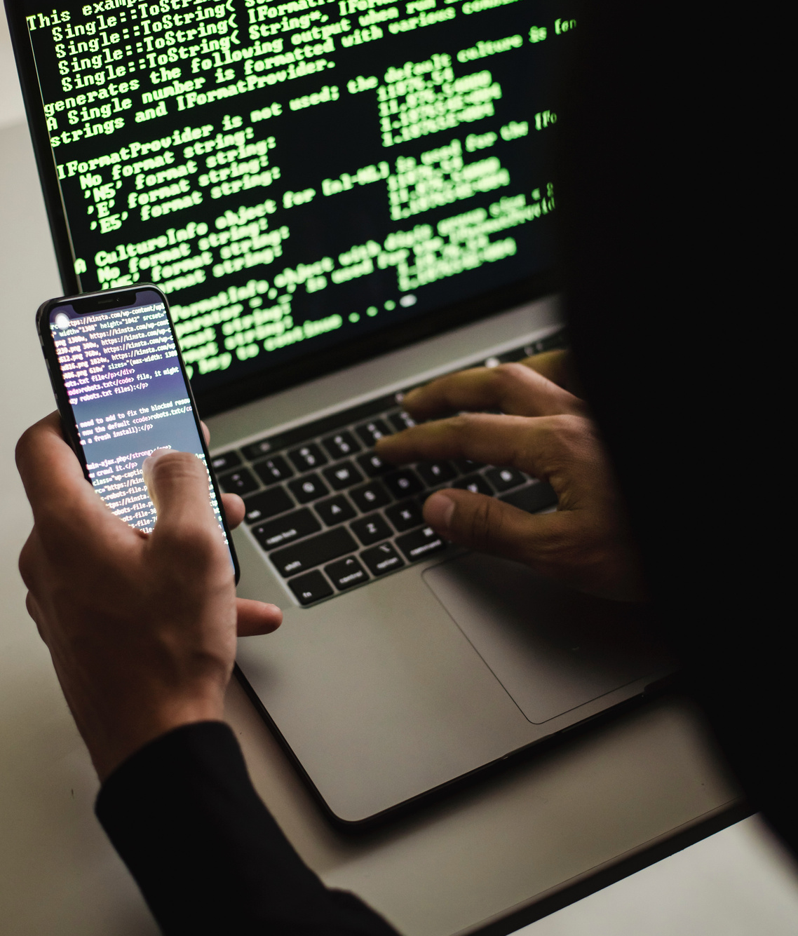
01.15.2026
THE HUMAN ELEMENT
IN CYBERSECURITY
People as the first line of defense
Common attack vectors that target humans
Think of cybersecurity like a castle. The firewalls, encryption, and security software are the stone walls and towers, but the guards at the gate—the people—are the first to spot intruders trying to sneak in. If the guards let someone disguised as a friend walk through without checking, the whole castle is at risk. That’s why employees, through vigilance and awareness, act as the true first line of defense
Phishing, social engineering, weak passwords
Cybersecurity isn’t just IT's responsibility, It’s all our responsibility

Slide 4

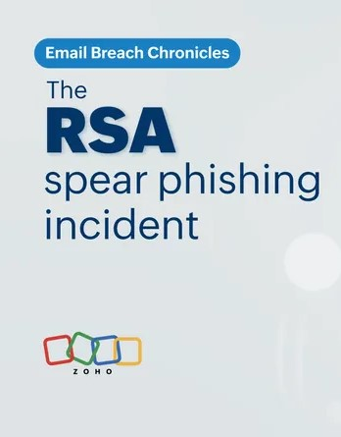
01.15.2026
UNDERSTANDING
SOCIAL ENGINEERING
Definition and examples
How attackers manipulate trust and emotions
Real-world case study
Definition:Social engineering is when attackers manipulate people into revealing information or taking actions that compromise security.
Example:A phishing email that looks like it’s from your bank, asking you to “verify” your account by clicking a link and entering your login details.
The 2011 RSA breach was a landmark cyberattack in which hackers used a spear phishing email with a malicious Excel attachment exploiting a zero-day Adobe Flash vulnerability to infiltrate RSA’s network and deploy the Poison Ivy malware. Once inside, they escalated privileges and accessed sensitive data tied to RSA’s SecurID two-factor authentication tokens, widely used by government agencies and defense contractors. The incident compromised the security of over 40 million users, cost RSA’s parent company EMC more than $66 million in remediation, and exposed the vulnerabilities of even leading cybersecurity firms. Ultimately, it highlighted the critical need for employee awareness, stronger defenses against advanced persistent threats, and vigilance
Security Is A Human Layer: RSA has advanced security tools, but the human element-the decision to open the an attachment was the critical vulnerability. This highlights that technology alone isn’t enough in protecting sensitive data.
They often pretend to be trusted figures—like banks, employers, or colleagues—to gain credibility. At the same time, they use emotional triggers to push people into acting quickly without thinking:
Fear: Warning that your account will be locked or you’ll lose money unless you act immediately.
Empathy/Helpfulness: Appealing to kindness, such as pretending to be a coworker in need of assistance.

Slide 5
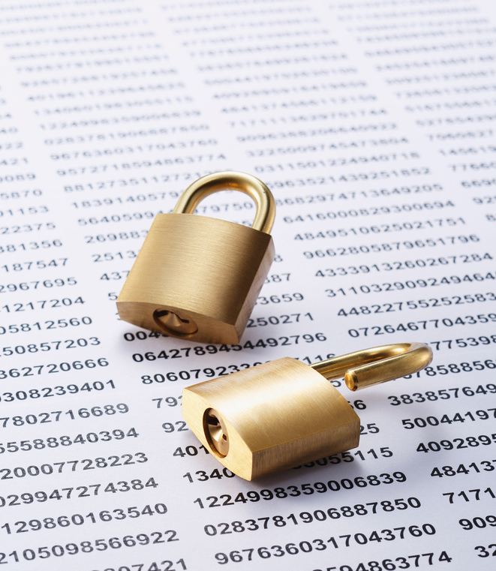
01.15.2026
What phishing looks like
Types
Email, SMS (smishing), voice (vishing)
Phishing is a cyber-attack that disguises itself as a legitimate message—often an email, text, or website—to trick you into revealing sensitive information. These messages may appear to come from trusted organizations like banks, delivery services, or government agencies. They often use official-looking logos, urgent language such as “Your account will be locked”, and links that lead to fake websites designed to steal your data.
How to spot red flags
Key warning signs include:
Unexpected requests for personal or financial information
Suspicious or misspelled links and email addresses
A sense of urgency or pressure to act quickly
THE MOST COMMON THREAT
PHISHING

Slide 6
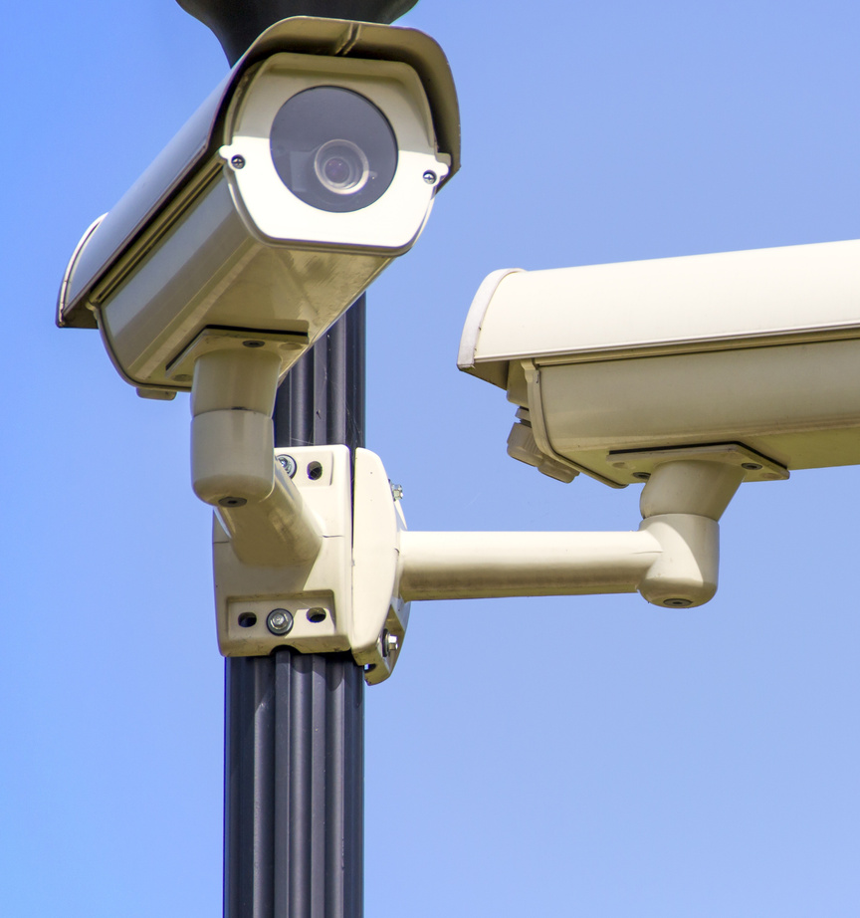
01.15.2026
PASSWORDS & AUTHENTICATION
BEST PRACTICES
Dangers of weak or reused passwords
Importance of password managers
Password managers are powerful tools that help you create, store, and manage strong, unique passwords for every account. Instead of relying on memory or writing them down, a password manager securely encrypts your credentials and automatically fills them in when needed.
Using weak or repeated passwords makes it easy for attackers to break into accounts. If one account is compromised, reused passwords allow criminals to access many others, leading to stolen data, identity theft, or financial loss. Strong, unique passwords are essential to protect both personal and organizational information.
Enabling multi-factor authentication (MFA)
Multi‑Factor Authentication (MFA) is a security measure that requires more than just a password to access an account, adding an extra layer of protection. It works by combining something you know (your password) with something you have (like a code sent to your phone or an authenticator app) or something you are (like a fingerprint). To implement MFA, go to the security settings of your account, enable options such as “Two‑Step Verification” or “Multi‑Factor Authentication,” and follow the prompts to link your phone, app, or device. This way, even if your password is stolen, attackers cannot access your account without the second factor.

Slide 7
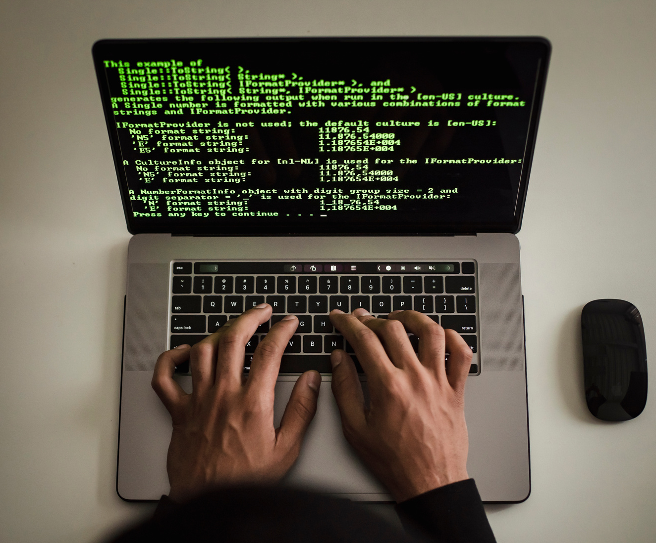
01.15.2026
SAFE ONLINE
BEHAVIOR
Think before you click
Verify sources and links
Phishing often relies on impulsive clicks. Always pause before opening links or attachments in emails, texts, or pop‑ups. If something feels urgent or suspicious, verify it first—clicking without thinking can expose your device and data to attackers.
Phishing messages often mimic trusted organizations. Double‑check the sender’s email address, look for spelling errors, and hover over links to see the actual destination before clicking. If in doubt, go directly to the official website rather than relying on embedded links.
Use secure Wi-Fi networks
Be cautious with downloads and attachments
Public Wi‑Fi may be convenient, but it’s often unsecured and vulnerable to hackers. Avoid logging into sensitive accounts or entering personal information on open networks. Instead, use trusted, password‑protected Wi‑Fi or a VPN to keep your connection safe.
Be Cautious with Downloads and Attachments. Attachments and downloads are common ways attackers deliver malware. Only open files from trusted sources, and be wary of unexpected attachments—even if they appear to come from colleagues or familiar companies. When unsure, confirm with the sender before opening.

Slide 8
01.15.2026
REPORTING AND RESPONSE
How to report suspicious activity in your organization
Why early reporting is critical
Role of incident response teams
Stops attacks before they spread
Limits damage and protects sensitive data
Gives security teams time to respond effectively
Prevents attackers from gaining deeper access
Follow your company’s reporting process (e.g., “Report Phishing” button or IT contact)
Forward suspicious emails to the security team
Never ignore or delete suspicious messages without reporting
Confirm with IT if you’re unsure how to proceed
Investigate and contain security threats
Analyze phishing attempts and remove malicious content
Strengthen defenses to prevent future attacks
Act quickly to protect individuals and the organization

Slide 9
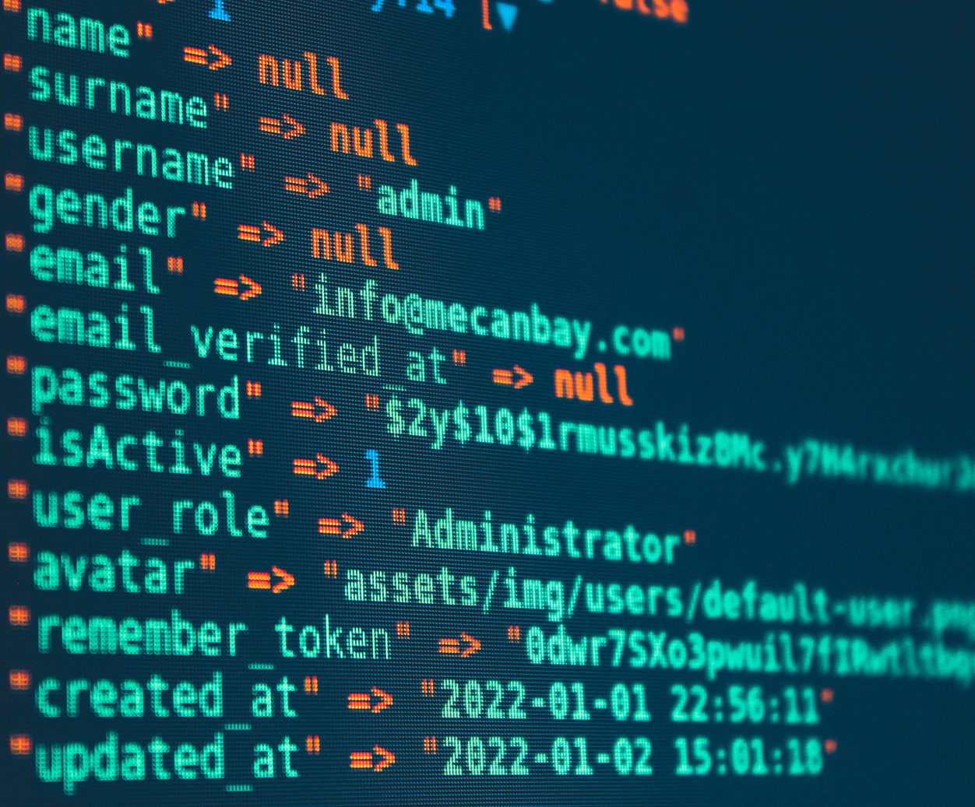
01.15.2026
BUILDING A CULTURE
OF CYBER AWARENESS
Regular training and simulations
Encouraging peer accountability
Cybersecurity as part of daily workflow
Ongoing training keeps employees alert to evolving threats
Simulated phishing exercises build practical awareness
Reinforces best practices through real‑world scenarios
Helps identify areas where extra support is needed
Every individual plays a role in cybersecurity
Report suspicious activity promptly and responsibly
Follow organizational policies and security guidelines
Understand that personal vigilance protects the whole team
Treat security as a routine part of work, not an extra task
Use strong passwords, MFA, and secure networks consistently
Verify links, attachments, and sources before engaging
Make safe online behavior a daily habit across all tasks

Slide 10


01.15.2026
FINAL THOUGHTS
& CALL TO ACTION
Recap
You are the human firewall
Take action today
Update passwords, stay informed, be alert
One small mistake can lead to a big breach
Remember, Digital safety starts with you
SANS Institute – Phishing Awareness Training
Offers professional training modules, simulations, and articles to help organizations build resilience against phishing.
Visit SANS Phishing Awareness Training (sans.org in Bing)

